Slide 1
Vegetables
Study Guide Notes

Slide 2
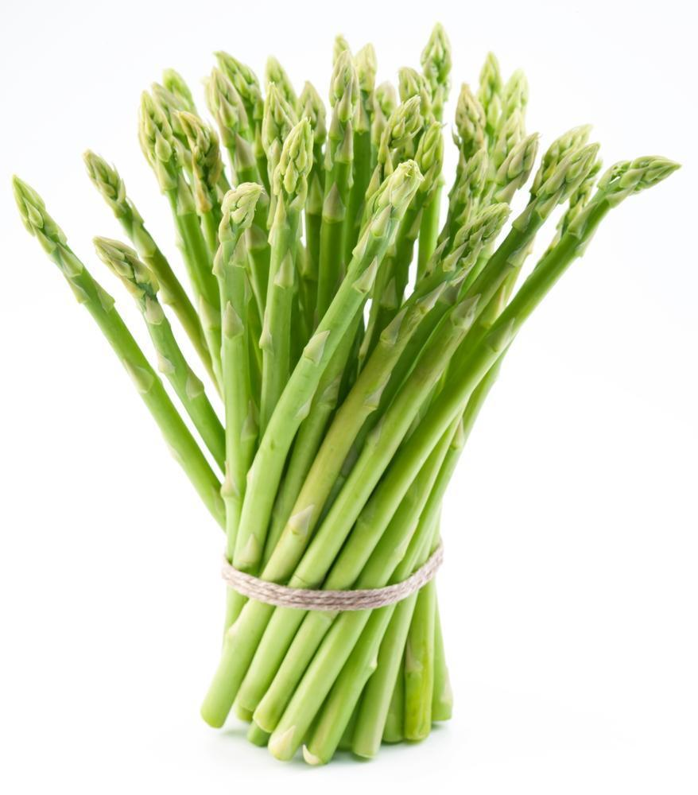
There are 8 types of vegetables!
Stem
Root
Flower
Fruit
Tuber
Bulb
Leaf
Seed

Slide 3
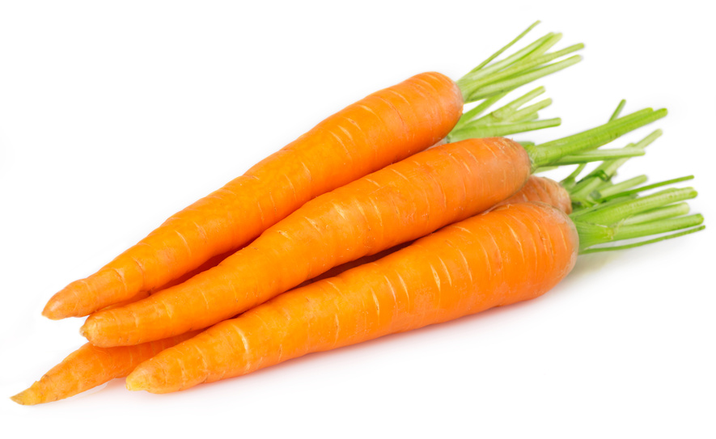
There are 8 types of vegetables!
Stem
Root
Flower
Fruit
Tuber
Bulb
Leaf
Seed

Slide 4
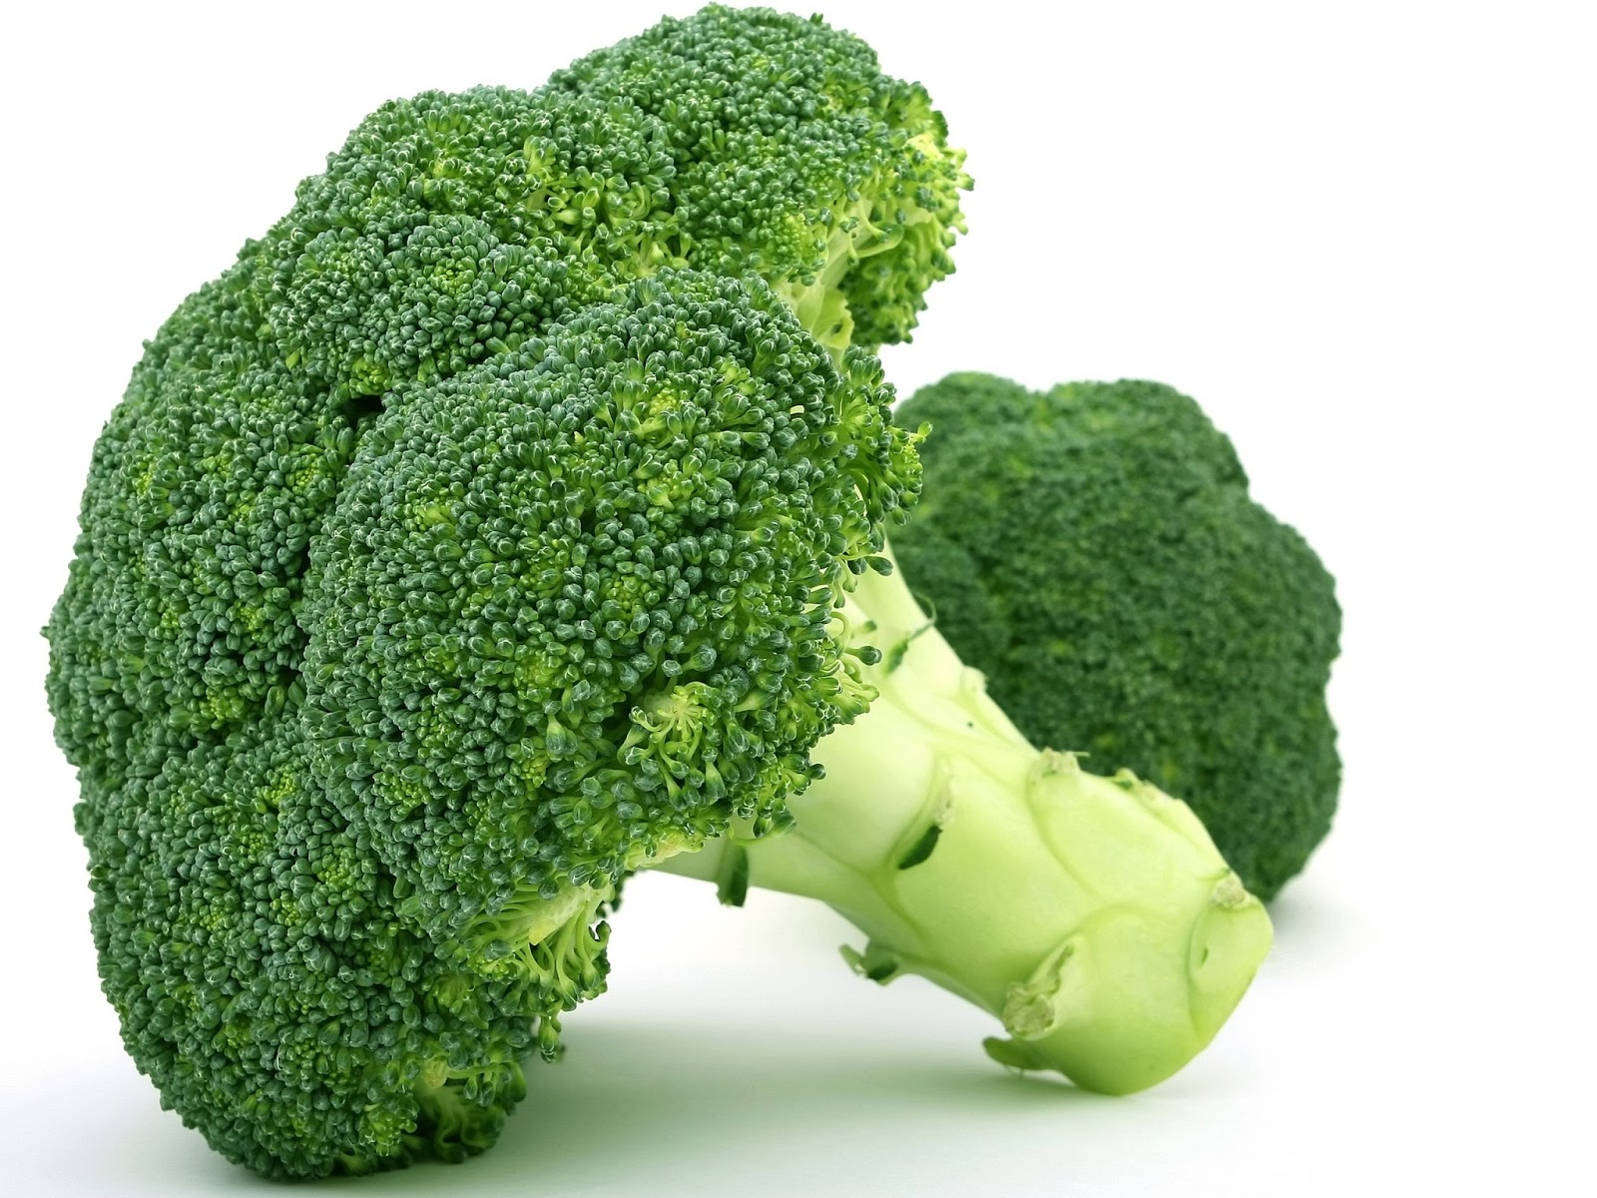
There are 8 types of vegetables!
Stem
Root
Flower
Fruit
Tuber
Bulb
Leaf
Seed

Slide 5
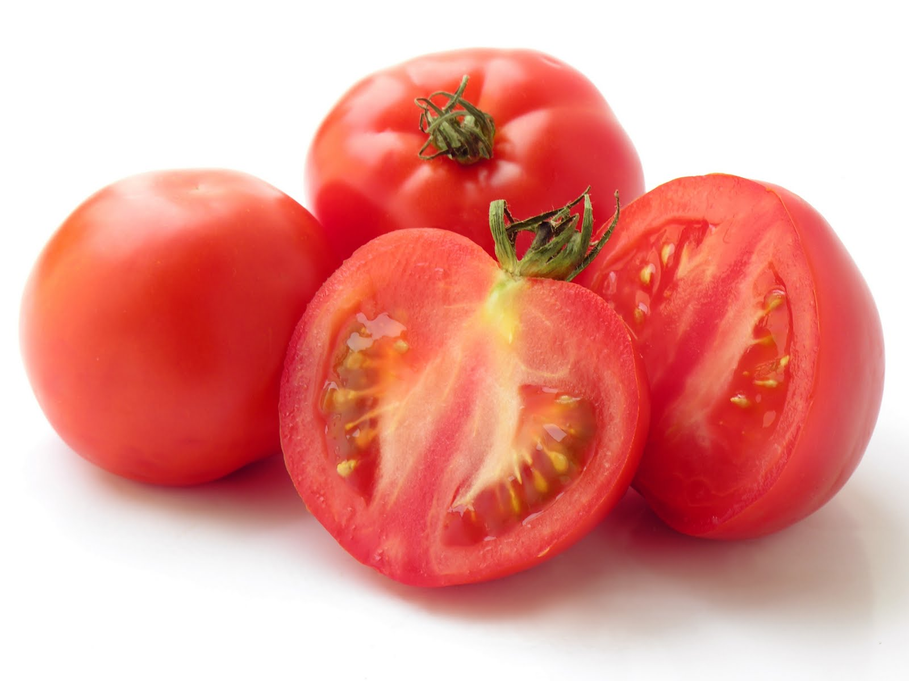
There are 8 types of vegetables!
Stem
Root
Flower
Fruit
Tuber
Bulb
Leaf
Seed

Slide 6
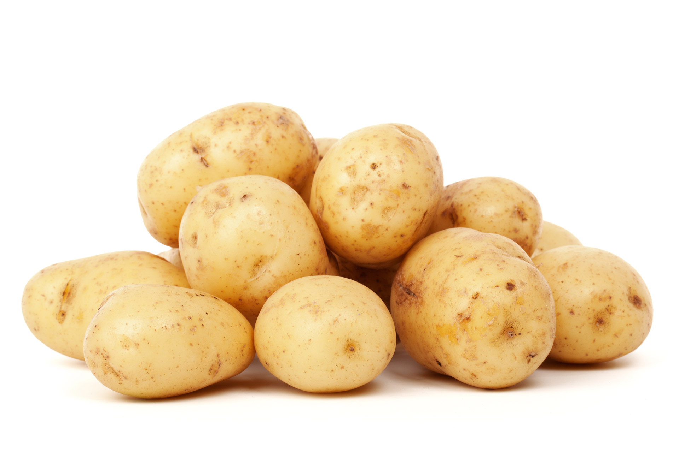
There are 8 types of vegetables!
Stem
Root
Flower
Fruit
Tuber
Bulb
Leaf
Seed

Slide 7
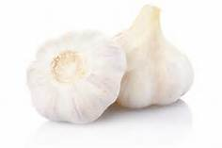
There are 8 types of vegetables!
Stem
Root
Flower
Fruit
Tuber
Bulb
Leaf
Seed

Slide 8
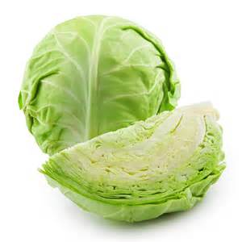
There are 8 types of vegetables!
Stem
Root
Flower
Fruit
Tuber
Bulb
Leaf
Seed

Slide 9
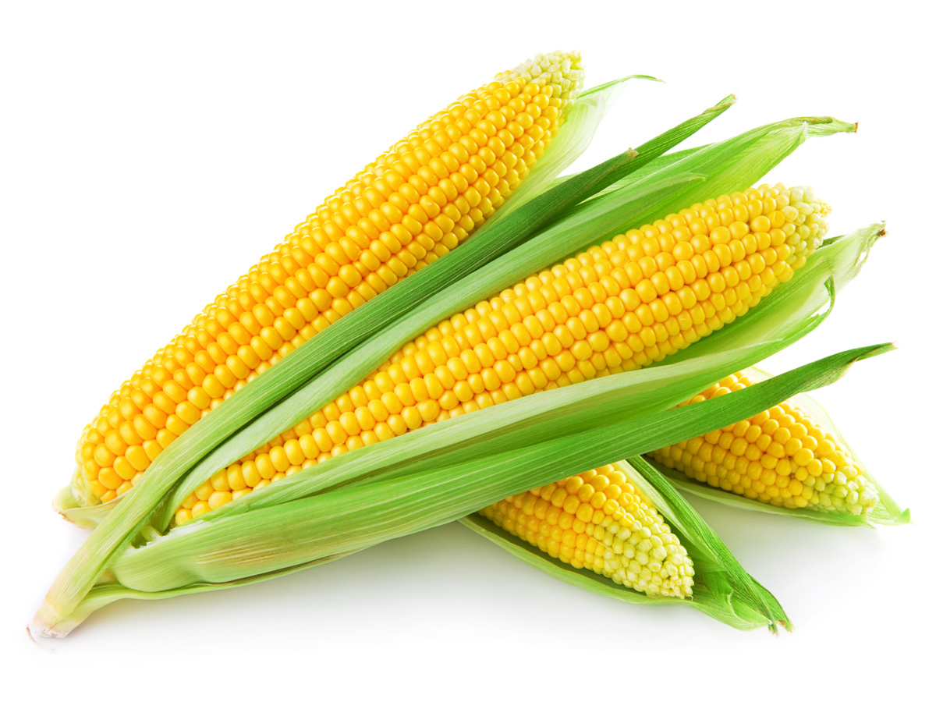
There are 8 types of vegetables!
Stem
Root
Flower
Fruit
Tuber
Bulb
Leaf
Seed

Slide 10
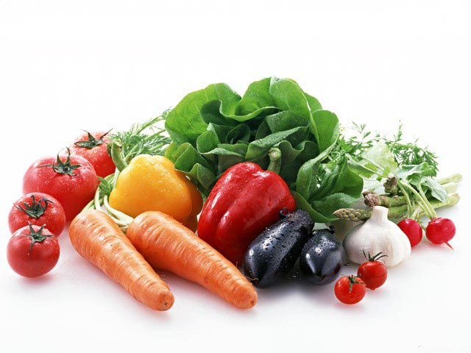
What parts of the vegetable contain the highest amounts of vitamins and nutrients?
The skin
And the layer underneath the skin

Slide 11
Which vegetable is a “super food”?
BROCCOLI

Slide 12
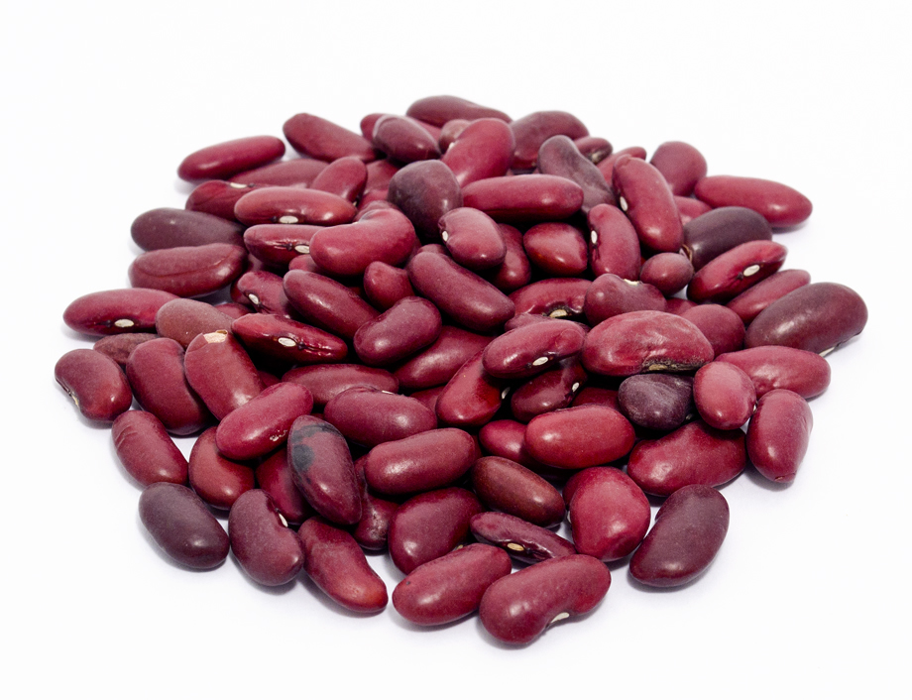
Fiber
While passing through the digestive system, fiber is thought to help eliminate toxins, and in the bloodstream, fiber can help keep arteries clearer of plaque buildup.

Slide 13
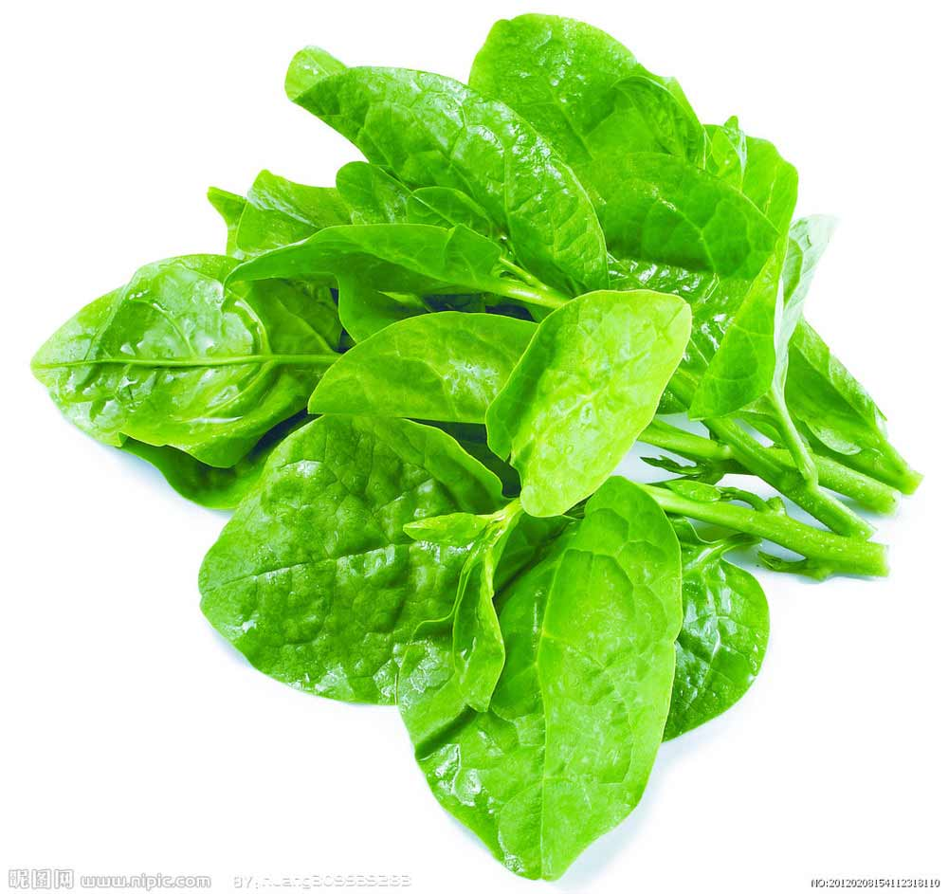
Potassium
Potassium is a major dietary mineral that helps balance your body's pH and body fluids. It's important for normal blood pressure regulation (it works in opposition to sodium). It's also needed for normal muscle growth, and for nervous system and brain function.

Slide 14
Vitamin A
Vitamin A is one of the fat-soluble vitamins, along with vitamins D, E, and K. It's needed for immune system function, normal vision, reproduction, and cell growth.

Slide 15
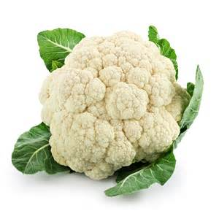
Vitamin C
Vitamin C is essential for normal growth and maintenance of most of the tissues of your body, including collagen, which is needed for healthy connective tissue and wound healing.
Vitamin C also helps your bones and teeth stay strong. It's also necessary to make certain neurotransmitters and for protein metabolism and your immune system relies on vitamin C too.

Slide 16
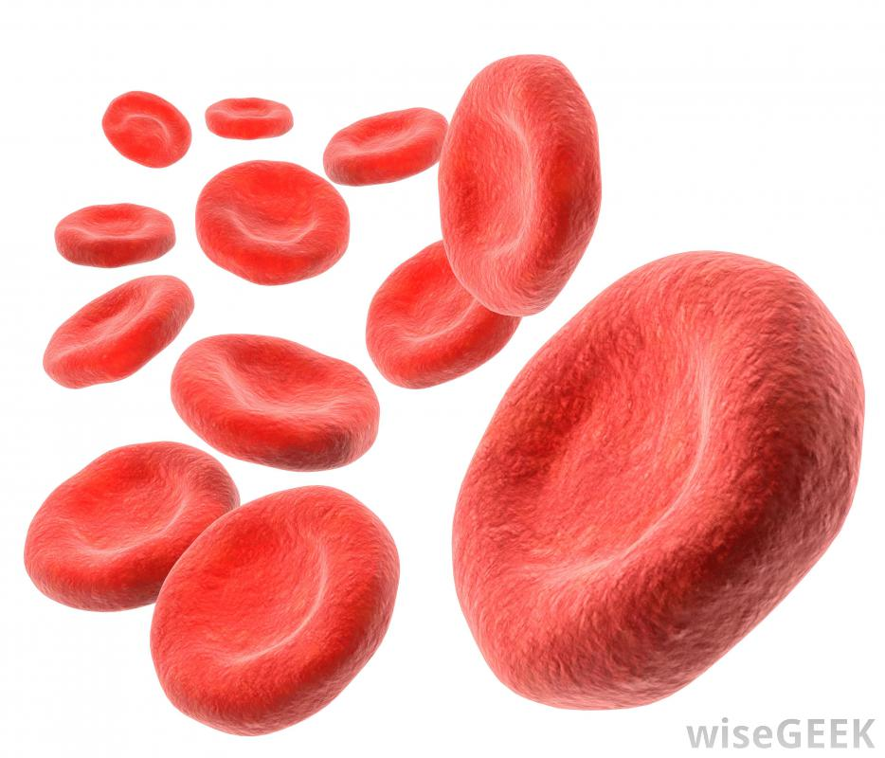
Potatoes!
Potatoes are a great source of iron which helps your body manufacture hemoglobin.

Slide 17
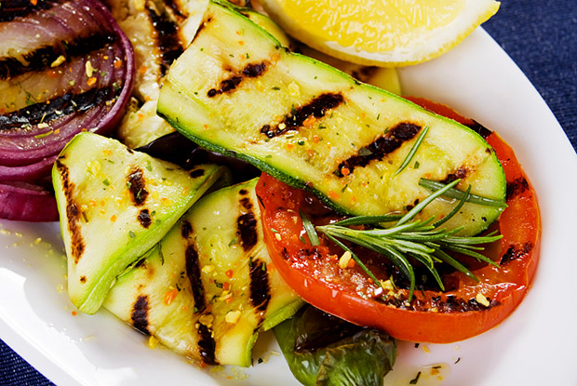
Which changes occur when vegetables are cooked?
The nutritional value decreases
Flavors mellow
Colors change

Slide 18
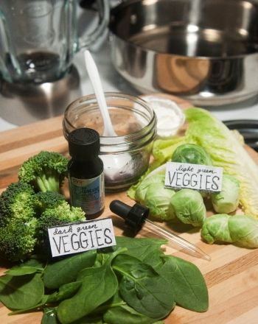
Darker green vs. lighter green leafy vegetables
The darker the green color of the leaf vegetable the more nutrients it packs!

Slide 19
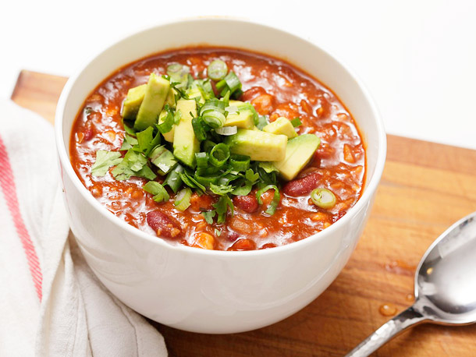
Vegetable meals?
Give an example of veggies served in a soup, main dish (entrée), and dessert!

