Slide 1
EGGS
Notes

Slide 2
NUTRITION
Two eggs have 80% of the protein needed daily and are only 160 calories.

Slide 3
NUTRITION
Protein – Needed for muscles, nerves, bones, and blood.
Riboflavin – Needed for helping cells to use oxygen.
Niacin – Needed for nerves and skin.
Iron – Needed for heathy blood.
Potassium – Needed for a healthy heart.

Slide 4
EGGS
What is the function of the chalazae?
It anchors the yolk in the center of the egg.
As the egg loses freshness, how does the appearance of the chalazae change?
It becomes thinner and less prominent.

Slide 5
EGGS
How big is the air cell in a high quality, fresh egg?
1/8 inch
What causes the air cell to enlarge in an egg?
The older the egg the larger the air cell.

Slide 6
EGGS
What is the “blood spot” you sometimes see on the yolk of a raw egg?
It is a ruptured blood vessel.
Should you eat an egg with a “blood spot” on the yolk?
Yes, it’s safe so you can eat it.

Slide 7
EGGS
What is a “break-out” egg test?
It’s when you break an egg on a flat plate.
What will a “break-out” test tell you?
It tests the freshness of the egg.

Slide 8
Break-out Egg Test

Slide 9
EGGS
What determines the color of an eggshell?
The breed of hen. White hens lay white eggs. Brown hens lay brown eggs.
Does the color affect nutrition, taste or quality?
No.

Slide 10
EGGS
Why is it important to buy only clean, graded eggs?
Health and safety from salmonella. Fresh eggs are not treated.

Slide 11
EGGS
Eggs should be stored in the refrigerator at 40°F.
How long will they be safe to use when store in the refrigerator?
1 month.
It is best to leave them in the carton. Store eggs with the pointed egg down.

Slide 12
EGGS
Eggs are very versatile; recipes use them for:
Binding ingredients
Leavening
Thickener
Coating
garnish

Slide 13
EGGS
Cook eggs at medium to low temperature. The protein will be tough at high temperatures.
In other words, eggs are a delicate protein and should be cooked slowly over lower temperatures.

Slide 14
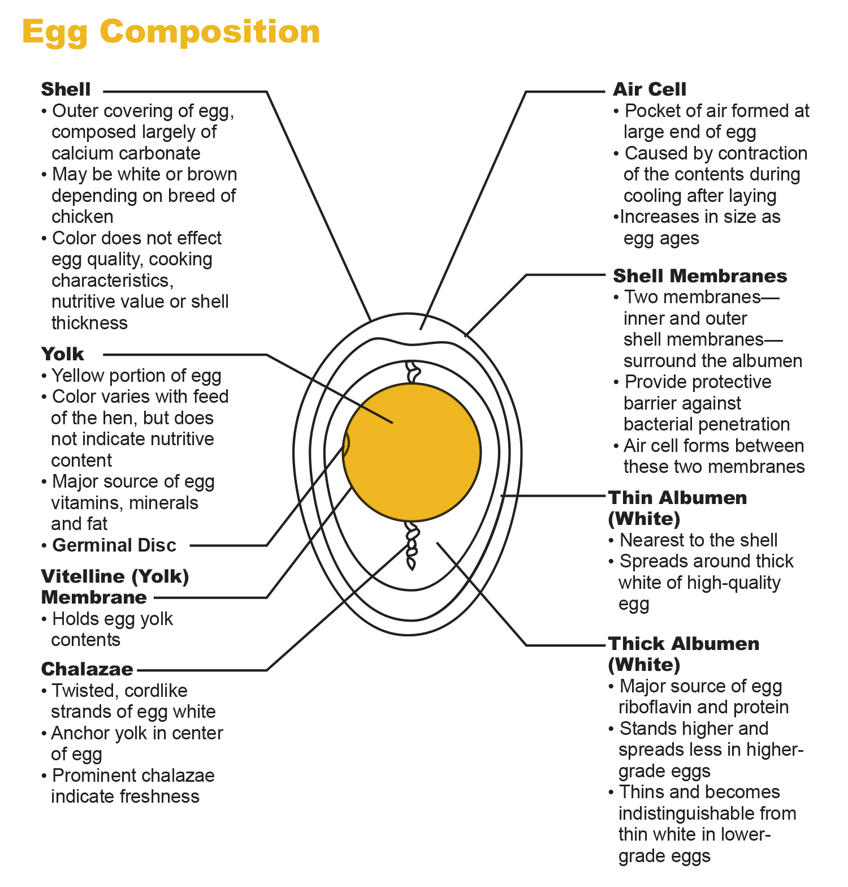

Slide 15
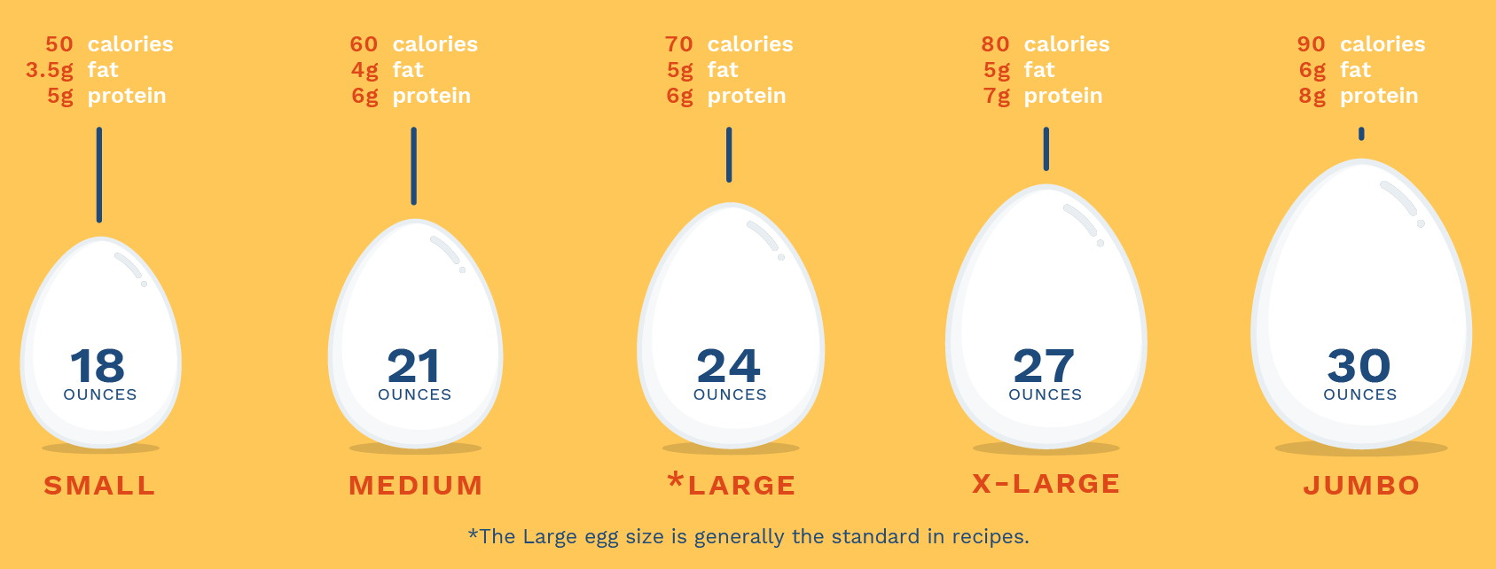
EGG SIZES AND GRADES

